Slide 1
FACE DETECTION ATTENDANCE SYSTEM(using MTCNN algorithm)
By: Nigam Rai
BCA 6th Sem

Slide 2
Table of Contents
Introduction
Objectives
Methodology
Algorithm
Tools and Technologies
Conclusion

Slide 3
Introduction
Innovative approach to tracking and managing attendance
system automatically identifies individuals by scanning their faces
prevent proxy attendance and reduce human error

Slide 4
Objectives
To provide a user-friendly interface where individuals can simply walk up to the system, have their face scanned, and their attendance recorded without manual intervention
To allow users and the admins to view attendance record.
To reduce administrative costs
To prevent fraudulent attendance (such as proxy attendance)

Slide 5
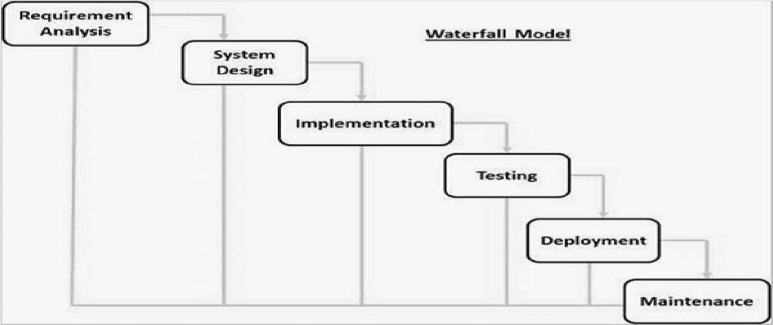
Methodology

Slide 6
Algorithms
Face Detection: MTCNN
Face Preprocessing: Histogram Equalization
Feature Extraction: Principal Component Analysis
Face Recognition(Matching):Euclidean Distance

Slide 7
Tools and Technologies
Frontend: React
Backend: Node Js and Python
Database: MongoDB
IDE: Visual Studio Code
Version Control: Github

Slide 8
Conclusion
Modern, efficient, and secure solution for automating attendance
Systems enhance accuracy, security, and user convenience through contactless technology

Slide 9
Scope
Automated Attendance Tracking
Contactless Authentication
Admin Panel for Monitoring

Slide 10
Existing Systems
Ncheck
Lystface
FaceIt Systems

Slide 11
Limitations
Affected by poor lighting, camera angles, and distance from the camera.
Facial changes (e.g., facial hair, makeup, aging) may reduce recognition accuracy.
Accessories like hats, glasses, or face masks can interfere with detection.
Collection and storage of sensitive biometric data (facial features) raises privacy issues.

